Slide 1
MIS 3339 Programming in Java I
Dr. Jeff Hill

Slide 2
Introduction
CRN: 18847
Location: CoB 308
Time: 9:25 AM – 10:40 PM (Tuesdays & Thursdays)
Email: ghill@uca.edu
Office: COB 305P
Hours:
TBD

Slide 3
Agenda
Course Introduction
Me
Theme
Concepts
Policies (Attendance, textbook & homework submissions)
Syllabus Highlights
Grades (Assignments, quizzes, exams & project)
Schedule
Success Factors

Slide 4
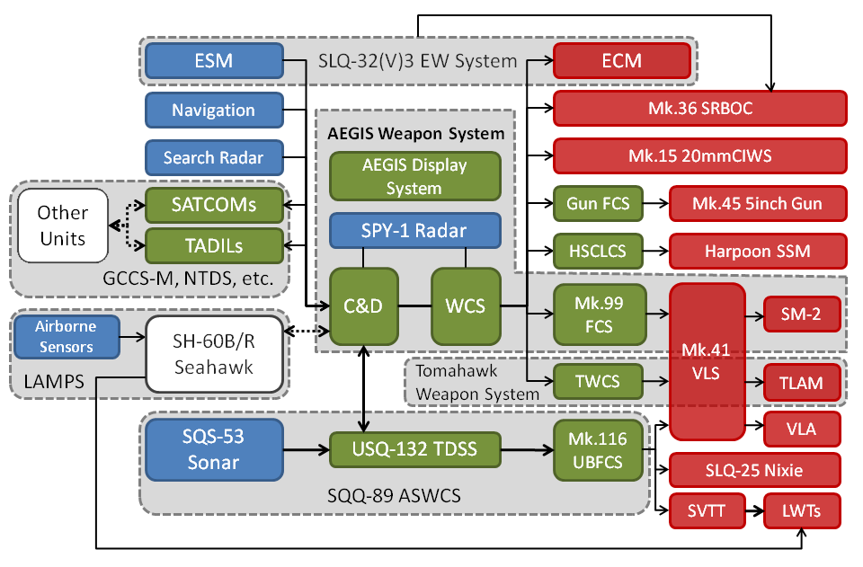
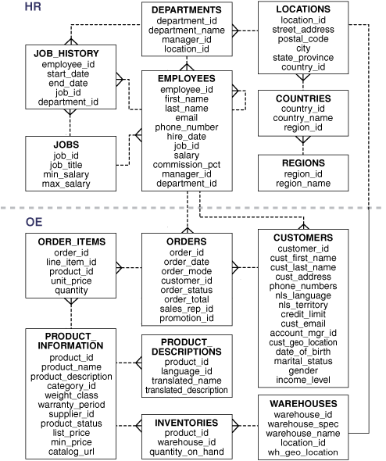
Experience
Taught over a dozen Java courses @UCA
Please feel free to offer any suggestions/recommendations throughout the semester
Industry experience designing, developing, implementing and supporting various complex systems
20 years programming experience across multiple languages
Mostly related to complex systems:
Enterprise Resource Planning (ERP)
Combat System integration and management
Line of Business (LoB)

Slide 5
Changes
This course satisfies requirements for the BBA elective programming course
This is the first time this course has been offered in this style
Starting this semester, MIS 3300 is a prerequisite for all MIS programming courses
This course is an intermediate programming course
You are expected to recall and apply fundamental programming concepts from MIS 3300
Variables & data types
Control structures: sequencing, selection, iteration, etc.
Modularity: void & value returning functions, modules, etc.
Logical planning tools (pseudocode, IPO charts, activity diagrams, etc.)

Slide 6
What does that mean?
As an intermediate course, you are expected to be self-sufficient
I will assist with concepts & logic, I will not assist with syntax
If you don’t enjoy solving complex problems on your own, this is not the course for you…
Previously, students treated the majority of their courses as independent silos
Just get through a course then purge the information
Next course starts it all over again from the beginning
Now, you’re expected to retain and apply information from prior courses
We will review (very fast!) these topics as we learn basic Java syntax
Why?
Because you’re expected to have this knowledge in order to get a job!
Not just have been exposed to it
Not only be able to perform with direct supervision
Programming languages are easy to learn… once you know the concepts
Concepts are difficult … syntax is easy…

Slide 7
What’s in it for me?
The most frequent reason I hear for selecting MIS as a major relates to career opportunities
Getting a job in the first place
Relative compensation
Growth and advancement potential
This course now serves as an intermediate stepping stone to acquire technical skills
As a general rule, regional companies hire based upon hard skills
Logical programming, database manipulation, system design, project mgmt…

Slide 8

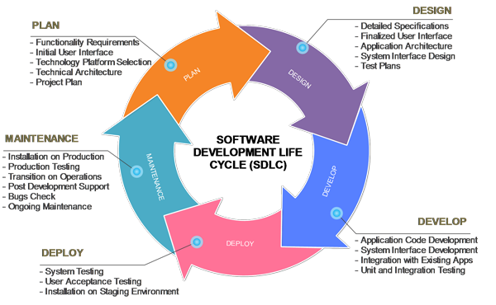
Course Theme
There are 2 main components:
Conceptual Understanding
Read the text, remember/learn the concepts, learn the Java syntax
Exam and quiz questions come from 4 key areas:
Definitions
Bullet lists
Charts/Figures/Graphics
Text body
Lecture is intended as a review, opportunity to clarify, combine & demonstrate ideas
Learning the “language of professionals”
Practical Application (next slide)
I won’t ask you:
On figure 3-8 did the person with an orange hat have his arms up?
I may ask you:
Which of the following activities does NOT occur during maintenance?

Slide 9
Practical Application
Skill assignments
Simple, single skill application of a focal subject concept
~30 – 60 minutes to complete
Homework assignments
Complex, multiple skill application of programming concepts
~60 – 180 minutes to complete
Team project
Complex, entire semester skill application of programming concepts
~10 – 20 hours per team member to complete

Slide 10
Key Course Concepts
This is an intermediate level programming course:
Focus on functionality
Other foci (security, efficiency, etc.) are left to follow-on courses and/or self-study
Java standard library
Modularity & reusable code
Object Oriented Programming (OOP)
Class design
Class construction
3rd party Application Programming Interfaces (APIs)
Database connectivity & web services

Slide 11
Attendance
This is a junior level course, attendance is expected
Missing >2 unexcused non-lab days will result in being dropped for non-attendance
Automatic ‘F’ if after the university’s drop date!
Recorded (sign-in sheet), not graded
No points just for “showing up”
If you are late, it is your responsibility to get on the sign-in sheet
Missed material is your responsibility
I will not cover the information again outside of class
Please email me before if at all possible that you won’t be in class…

Slide 12
Text
Lewis & Loftus: Java Software Solutions, 8th Ed., 2014. ISBN: 978-0-13-359495-9
Any page references provided by me will be based upon this edition
Yes, it is required
Daily reading expectations
Schedule in the syllabus
Some days “Blackboard Reading List” is provided
Exam questions almost exclusively come from the readings
Quiz questions are exclusively from the readings

Slide 13
Blackboard
Course will be run through BB Learn
View these additional documents:
Professor’s E-mail Guidelines
Course Software
Link to download and vendor installation instructions included!
Eclipse & Java Developer Kit (JDK)

Slide 14
Grading
6 skill assignments (only count 5 best) (20%)
20 points each
6 homework assignments (24%)
20 points each
19 quizzes (only count 16 best) (16%)
5 points each
2 exams (20%)
2 parts – 25pts (knowledge) 25pts (practical)
Administered online in Blackboard
MUST be taken in-class on exam day (see schedule in syllabus)
1 team project (20%)
100 points
3 deliverables
500 points total
Round up at .5% (rounding only occurs for the final total)
Extra credit is only available on practical assessments

Slide 15
Homework
Assignments are to be submitted to Blackboard by due date @11:59 PM
Attach all necessary .JAVA file(s) to the BB assignment
No late submissions accepted for any reason
Blackboard occasionally has connectivity issues
Don’t wait until the last minute to submit

Slide 16
Quizzes
Quiz every day there is assigned reading
Given at the beginning of class, timer based presentation
5 questions, 40 seconds each, closed book, open notes!
If you are late…
No additional time
Won’t re-show missed question(s)
If you are absent…
No make-ups
19 quizzes total, count best 16
Quiz questions are all part of the exam question pools!
Quizzes are to incentivize you to read, and to reward you for doing so

Slide 17
Exams
25 questions
40 minute time-limit
Multiple choice, true/false, fill in the blank, code evaluation, etc…
Closed book, open notes!
1 medium difficulty programming task
30 minute time-limit
Closed book, open notes!
Make-up exams only given for extraordinary circumstances
Contact me prior to missing an exam if at all possible
Exam questions will come largely (but not exclusively) from the assigned readings
We don’t have to specifically cover it in class for it to be seen on a test

Slide 18
Schedule
Class | Date | Pages | Topic
1 | 8/27 |  | Class introduction & syllabus
2 | 8/29 | 26 – 49 | Introduction: Java, conventions & expectations, class-based OOP, main method, Java packages & projects (In-class Demo: Eclipse & Java)
 | 9/3 |  | Labor Day (No class)
3 | 9/5 | 58 – 75 114 – 116 141 – 143 204 – 226 | Review: Data types, variables, scope, primitives & reference, wrappers & autoboxing, logic control structures: sequence & selection
Remainder of the schedule is on the last page of the syllabus

Slide 19
Class Rules
Polite, courteous, and professional interactions at all times
Cell phone usage is not permitted during class for any reason
Recording of classes is prohibited
Academic honesty is expected and required
No copying code – debugging help is ok, copying is considered plagiarism
Don’t show others your code, if they need assistance then work using their code
This includes self-plagiarism!
Infractions will be handled according to University and syllabus policy

Slide 20
Success Factors
http://www.tutorialspoint.com/java/index.htm
http://www.codeproject.com/KB/java/
http://docs.oracle.com/javase/tutorial/
http://www.javabeginner.com/
READ THE ASSIGNED READINGS
Scanning once is not enough
Take good notes
This is NOT a theory course or a survey course
This IS an applied technical course, 2 key components
Concepts: learn the language of professionals (quizzes & exams) (~25%)
Usage: demonstrate using the concepts (assignments & project) (~75%)
Use external resources, Google knows all…
Google also knows plagiarism, don’t copy!

Slide 21

Questions about the syllabus and/or course?

